Slide 1
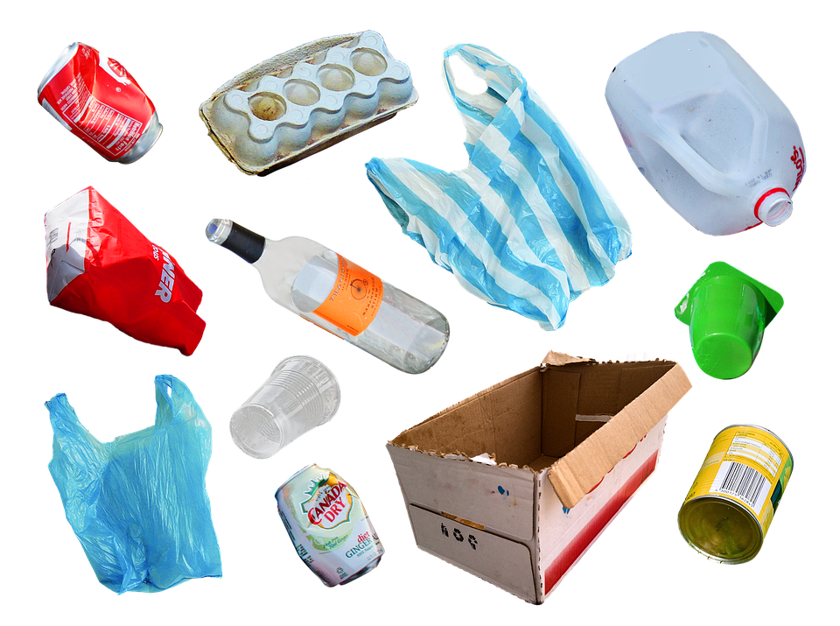

Plastic waste:
an overview
2 0
2 3
Exploratory Data Analytics
Ana Vigueras Rodriguez

Slide 2
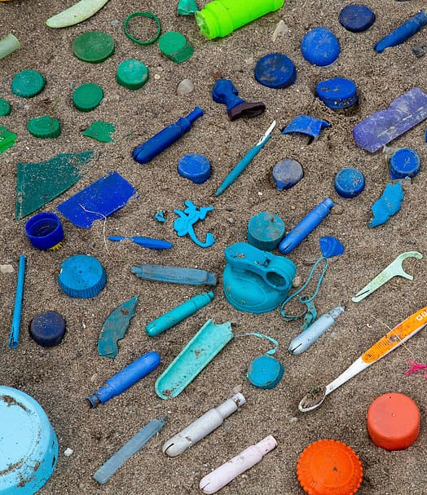
Contents
Plastic waste management 2000-2019
Motivation
Questions
Conclusions
Sources

Slide 3
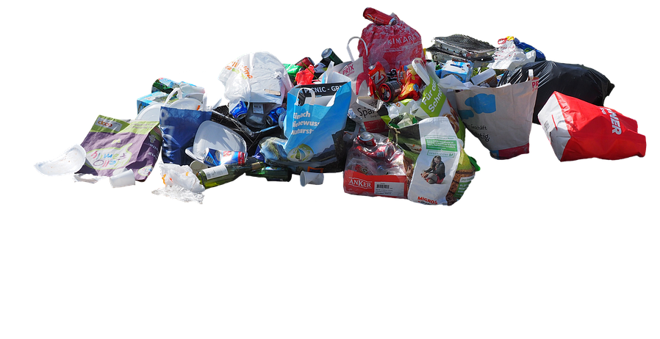
🚀 Motivation
Notes:
Speaker: Gabrielle

Slide 4
By now, we all are probably familiar with these facts:
Plastic production requires large amounts of fossil fuels, contributing to greenhouse gas emissions and climate change.
Many types of plastic cannot be recycled, leading to them being disposed of in landfills or incinerated.
Plastic takes hundreds of years to decompose and can harm wildlife and ecosystems in the meantime, especially marine life.
And for that reason, we see campaigns everywhere, products and all sorts of initiatives but, did we really reduce plastic consumption or increment recycling or is it more about feeling better about ourselves?
🥤🥤🥤
Let’s see!

Slide 5
🤔 Questions
Notes:
Speaker: Gabrielle

Slide 6
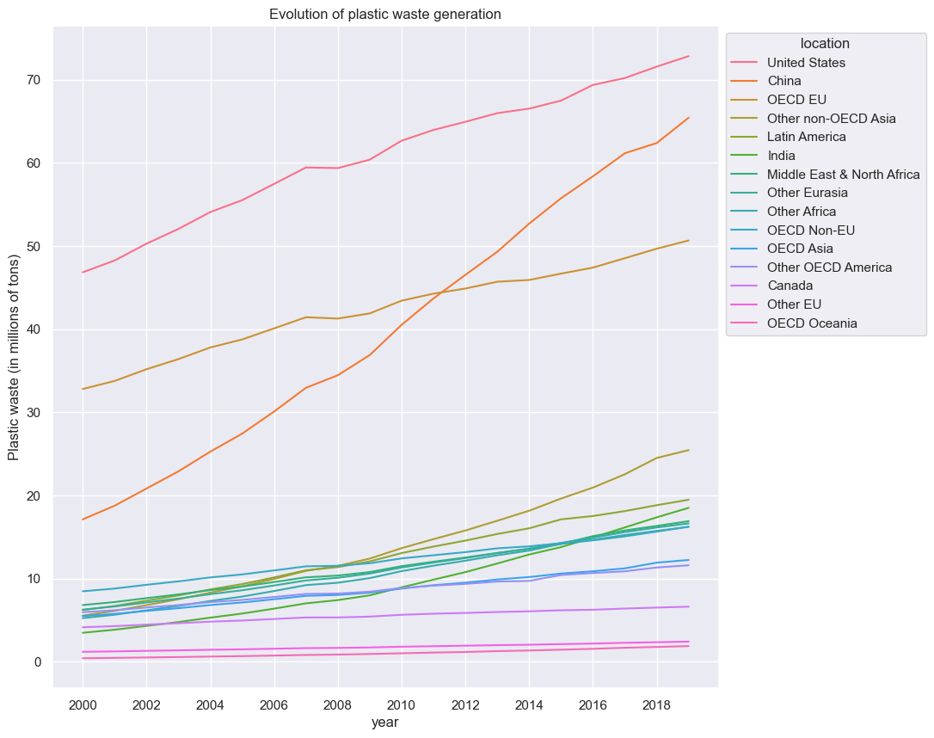
🥤 What are the top 3 areas that generate the most plastic waste?
And the winner is…
United States
China
OECD EU (yep, that’s us!)

Slide 7
But I’ve seen that the EU used to be the second producer of waste so…
🥤Did the European Union reduce its plastic waste in the last 5 years?
Although EU used to be the second and it is now the third in terms of waste generation, the reason for it is just because China generates more plastic waste now. Overall all areas increased.

Slide 8
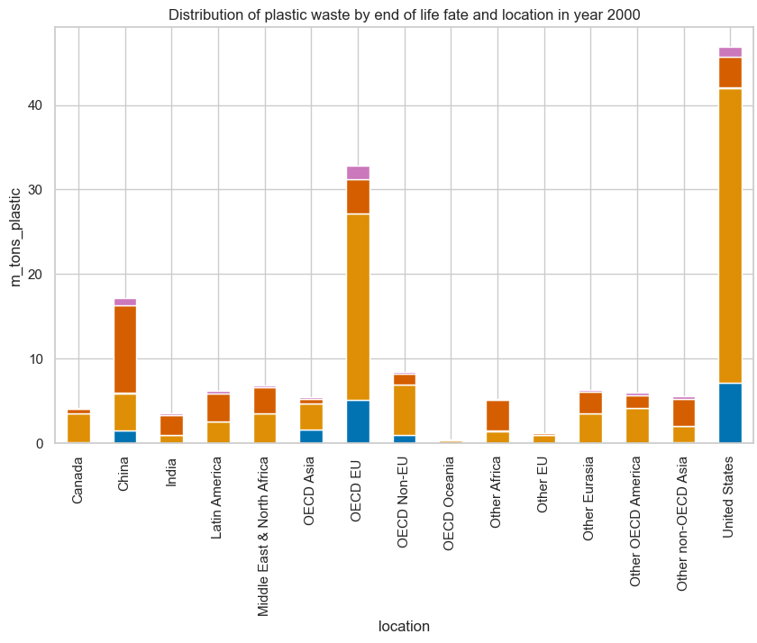
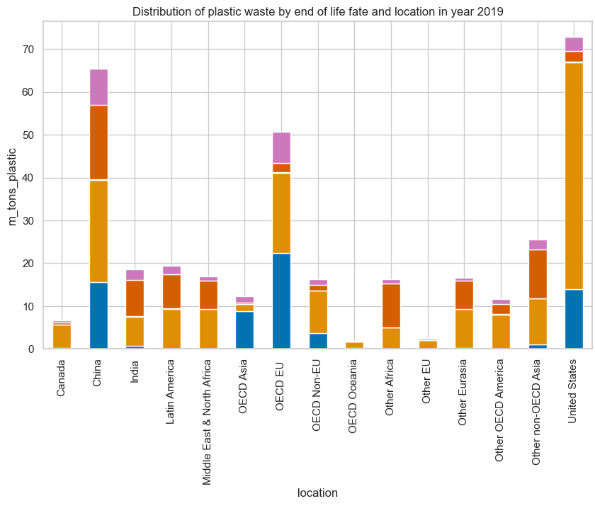
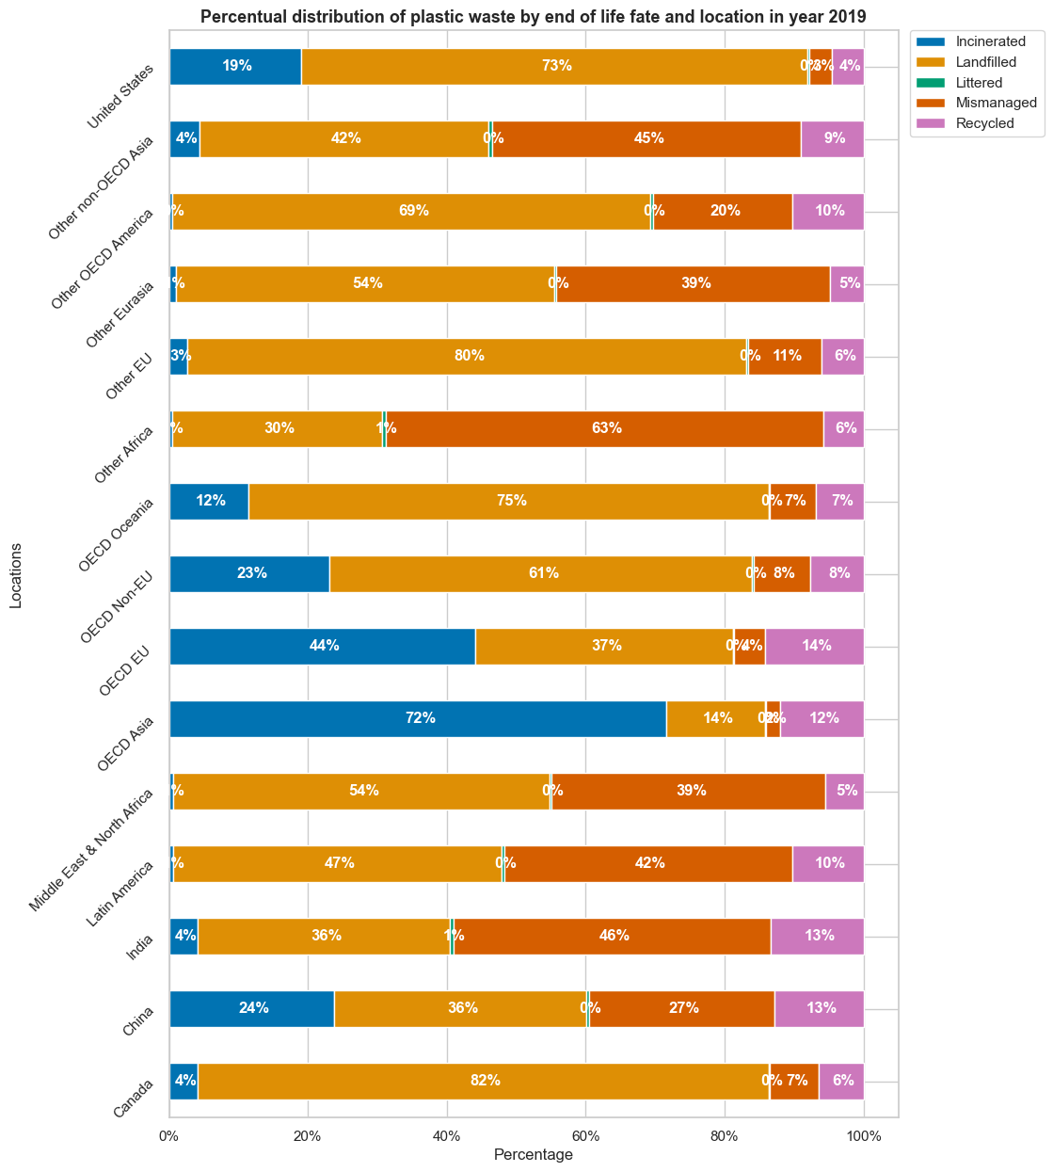
Alright I see, but surely with so many campaigns most of it is being recycled now…
🥤How much all used plastic is mismanaged? What about landfill?

Slide 9
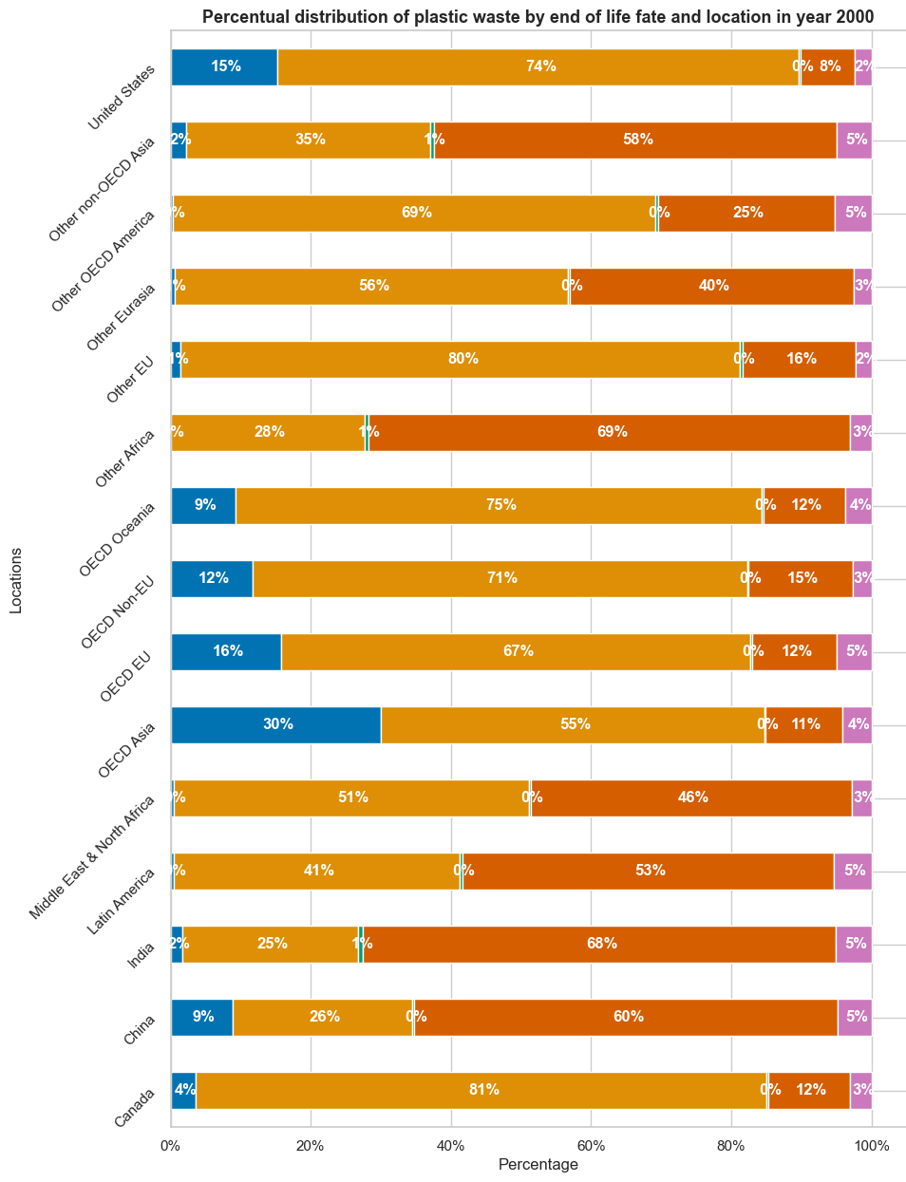
Wait, what?
♻️ Which % of all used plastic was actually recycled over the last 20y?

Slide 10
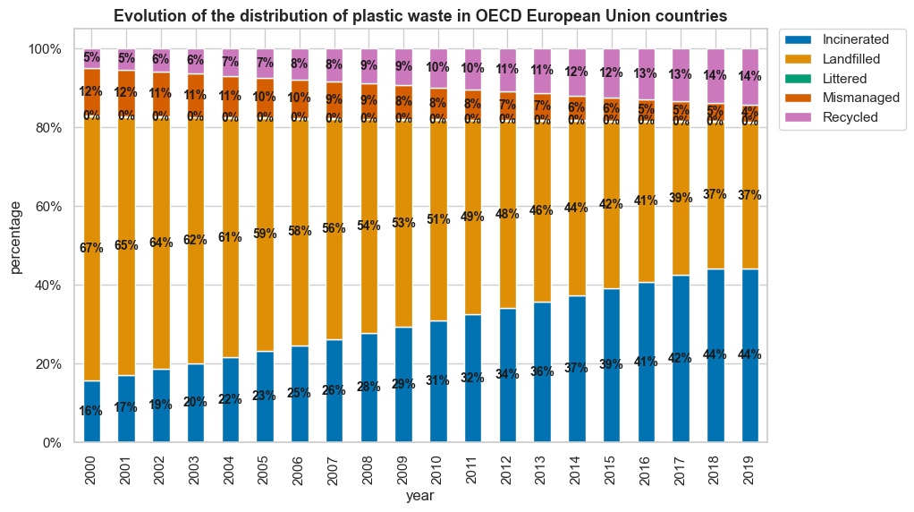
Oh, I see… What about the EU?
♻️ How did the % of recycled plastics improve in the EU in the last 20y?
From 5 to 14%!
Finally something positive

Slide 11
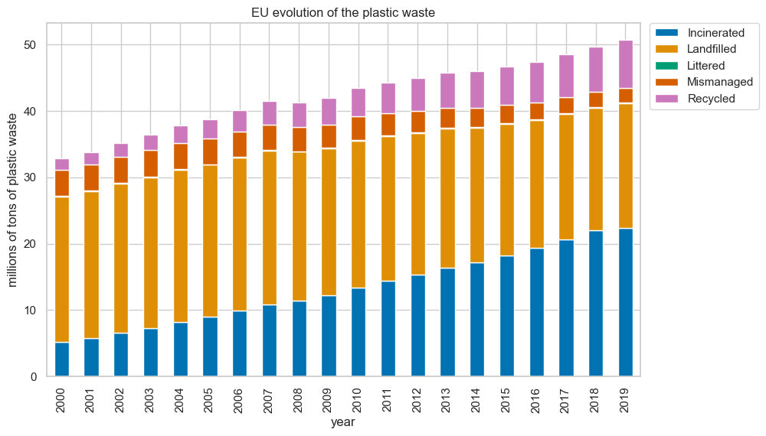
Good news! So…
🥤Does that compensate for the bigger waste?
Sadly, no.
The amount of plastic waste that the EU produces now is simply to high for that.

Slide 12
💡 Conclusions
Notes:
Speaker: Gabrielle

Slide 13
Here are some silver linings:
🥤 The amount of mismanaged plastic waste (main reason of ocean plastic pollution) has greatly decreased in the last 20 years.
🥤 The EU is leading in terms of recycling with a 14% of all plastic waste.
And a conclusion:
🥤 It’s not that much about recycling individually, as many plastics cannot be recycled, but about reducing consumption as a whole.

Slide 14
🔗 Sources
Notes:
Speaker: Gabrielle

Slide 15
Sources:
OECD (Organisation for Economic Co-operation and Development):
🔗 Plastic waste by region and end-of-life fate (link)

Slide 16
The End
Notes:
Speaker: Gabrielle

